Slide 1
OO Boot Camp
Lesson 2 – Length Calculation

Slide 2
Review

Slide 3
Tasking
分解问题：
1. 任何子问题均可通过测试来验收
2. 所有子问题域的集合恰好等价于原问题域
3. 子问题域之间无交集
计划任务：
能够递进地解决所有子问题
其他任务与子问题放在同一列表中被计划
追踪进度：
在列表中随时勾除完成任务或加入新增任务

Slide 4
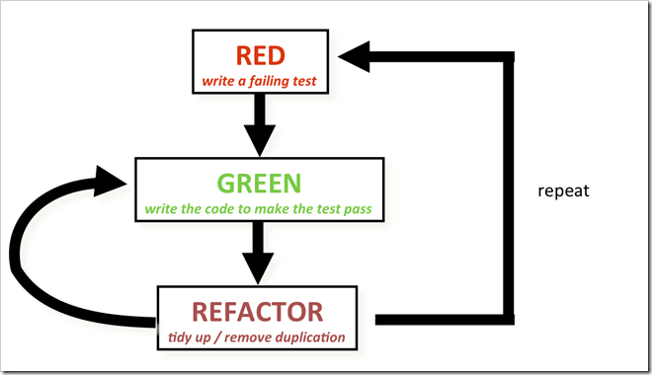
How do we do TDD

Slide 5
EXERCISE
设计一个长度类库
使它可以计算这样的计算公式
1m / 4 + 10cm * 3 – 5mm
= 545mm = 54.5cm = 0.545m
Notes:
1. 先做Tasking, Taking 树状图

Slide 6
Tasking
Length
Calculation
Addition
Equation
Same Unit
Different Unit
Multiplication
Division
Subtraction
Notes:
基础Story为Equation.SameUnit
可能会有部分不认同, 基础Story应该为Equation.SameUnit + Calculation.Addition
做好了Tasking后写出第一个测试, 通过Issue进行反馈

Slide 7
Task List
Equation with same unit
Equation with different unit
Addition
Subtraction
Multiplication/Division
提交Task 1的测试用例至:
http://github/OOBP-SH/issues/2
Notes:
仅作红色部分
不要多做, 做的越多, 错的越多

Slide 8
First Test Case
ASSERT_EQ(Length(10.5, "m"), Length(10.5, "m"));
Notes:
对比大家的测试, 应该有不同的实现
通过测试描述了接口, 跟客户约定好了交付的内容

Slide 9
Task List
Equation with same unit
Equation with different unit
Addition
Subtraction
Multiplication/Division
提交或清空当前工作区:
git add . && git commit && git push
git reset && git checkout . && git clean –fd
git stash
git remote add source http://github/OOBP-SH.git
git pull source master
Notes:
仅作红色部分
不要多做, 做的越多, 错的越多

Slide 10
Unit Definition
ASSERT_EQ(Length(10.5, "M"), Length(10.5, "m"));
ASSERT_EQ(Length(10.5, "米"), Length(10.5, "m"));
enum {M = 1000, CM = 10, MM = 1};
ASSERT_EQ(Length(10.5, M), Length(10.5, M));
Notes:
客户需求并不清晰, M是否支持大小写? 是否支持中文, 为什么不支持
细化接口, 同样接口作为约束
重构练习

Slide 11
Task List
Equation with same unit
Equation with different unit
Addition
With Same Unit
With Different Unit
Subtraction
Multiplication/Division
Notes:
在此时细化Task
分别完成同单位, 不同单位

Slide 12
Value Object
Follow value semantics rather than reference semantics.
Value objects should be entirely immutable.
If you want to change a value object you should replace the object with a new one and not be allowed to update the values of the value object itself.
Notes:
1. 值类型, 参照Java String

Slide 13
Value Object
Length(10.5, "m") + Length(10.5, "m")
Length(10.5, "m") * 5
Length(10.5, "m") / 5
Length(10.5, "m") * Length(5, "m")
Length(10.5, "m") / Length(5, "m")
Notes:
下面的是否能做?

Slide 14
SUMMARY
通过测试来确认需求
接口是与客户的协约
场景是对需求的确认
Task延迟细化
Value Object

Slide 15
Q & A

Slide 16
Thank You
For questions or suggestions:
Liu Jie
jieliu@thoughtworks.com

